Slide 1

Table of Contents
1. Introduction
2. The Problem
3. Elysium's Solution
4. Our Offerings
5. Target Customer
6. Capital Raise
7. Summary

Slide 2


Slide 3
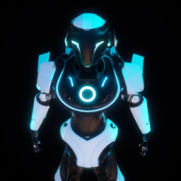
Greetings!
Hello Chris Dixon, welcome to our presentation on Elysium OS!

Slide 4

The Problem
Fragmentation hinders AI adoption. Disjointed user experiences, operational inefficiency, limited cross-compatibility, barrier to entry, and security concerns are preventing collaboration and widespread adoption of AI.

Slide 5

Elysium's Solution
Elysium OS provides a seamless user experience, dynamic ecosystem integration, a unified AI network, and a secure platform. We empower developers to build secure, decentralized AI tailored to individual needs.

Slide 6
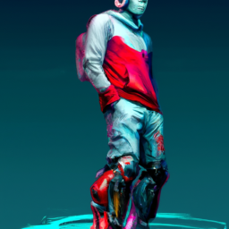
Our Offerings
Elysium OS offers a unified portal for accessing personalized AI Butler or Chief of Staff. It provides 24/7 access, seamless interaction, robust customization, and powerful capabilities. Automation Station streamlines AI agent recruitment and deployment.

Slide 7

Target Customer
Developers face the problem of inaccessible and disconnected AI agents. Elysium OS serves as a value-added catalyst, providing a single intuitive entry point for consumers to use their technology and platforming all their AI agents in one place.

Slide 8

Capital Raise
We are raising $3,500,000 in our Seed round to hire UX/UI designers, OS lead, backend & support devs, for growth via new marketing channels, and full platform development.

Slide 9

Summary
Elysium OS empowers developers by offering a unified platform for building secure, decentralized AI. With seamless user experience, dynamic ecosystem integration, and a secure platform, Elysium OS is the catalyst for AI adoption.

